Slide 1
Software Metrics
SE 611

Slide 2
Outline of The Course
Module 1: Measurement theory
Module 2: Software product and process measurements
Module 3: Measurement management

Slide 3
Measurement Theory
The basics of measurement
Overview of software measurement metrics
Framework for software measurement
Empirical investigation
Analyzing software measurement data

Slide 4
Software Measurement
Measuring Internal Product Attributes: Size and Structure
Measuring External Product Attributes
Making Process Predictions: estimate effort, size, release date
Software Reliability: Measurement and Prediction

Slide 5
Measurement Management
Planning measurement
Resource management: productivity, teams, and tool
Support for measurement

Slide 6
End of This Course…
What is software measurement about?
Why software measurement is important
What does empirical investigation mean in the SE context
What is software measurement metrics
What is software measurement process
How to implement a software measurement plan
Challenges and difficulties of applying software metrics

Slide 7
Chapter 1: Measurement
Measurement: What Is It and Why Do It?
What is Software Metrics
Scope of Software Metrics

Slide 8
Measurement
Measurement is the process by which numbers or symbols are assigned to attributes of entities in the real world in such a way so as to describe them according to clearly defined rules.
Thus, measurement captures information about attributes of entities.
An Entity is an object or event in the real world
An attribute is a feature or property of an entity
Two general types of attributes in SE: Internal (e.g., code, size, and modularity) and External (e.g., reliability, maintainability)
The accuracy depends on the measuring instrument (or metrics)

Slide 9
Measurement in Software Engineering
Measurement in SE is selecting, measuring, and putting together many different attributes of the software and adding our subjective interpretation in order to get a whole picture of the software
A good software must be reliable, user-friendly, and maintainable
So? Is measurements necessary?
What are the effect of neglecting proper measuring in SE?

Slide 10
Neglecting of Measurement in SE
Failure to set measurable targets for the product (e.g., how user-friendly, reliable, and maintainable a product is)
Failure to understand and quantify the component costs of a software project, e.g., difference between design cost, coding cost, testing cost
Failure to quantify or predict the quality of product. Thus potential user can not be informed how reliable a product is.

Slide 11
Metrics
Metrics are standards ( i.e., commonly accepted scales, measurements or quantifiable indicators) that define measurable attributes of entities, their units, and their scopes.
Software Metrics are measures that are used to quantify software, software development resources, and/or the software development process
Common Software metrics: size metrics, effort metrics, quality metrics, productivity metrics, maintainability, and reliability metrics.
“What is Not Measurable Make Measurable”

Slide 12
Mathematical Perspective of Metrics
A metrics is a function m defined on pairs of objects x and y such that m(x,y) represent the distance between x and y. Such metric must satisfy certain properties
m(x, x) = 0 for all x
m(x, y) = m(y, x)
m(x, z) <= m(x, y) + m(y, z) for all x, y, and z
Example
"Login module has 500 LOC" --> Measurement “Line of Code (LOC)” --> Metrics

Slide 13
Software Metrics Challenges
SE Metrics are mostly non-physical
Reliability, maturity, portability, flexibility, maintainability, etc., and relations are unknown
Choosing the right metrics can be challenging.
Gathering accurate and reliable data for metrics can be a challenge.
Tracking too many metrics can overwhelm teams and make it difficult to focus on the most important aspects.
Metrics may not capture all relevant aspects of software development, and they can be influenced by subjective judgments and biases.
There is a risk of metric manipulation, where individuals or teams may intentionally or unintentionally manipulate metrics to present a favourable picture
Software projects and technologies evolve rapidly, and metrics that were once effective may become outdated or less relevant over time.

Slide 14
Objective of Software Measurement
From manager perspective
How does each process cost?
How productive is the staff?
How good is the code being developed?
Will the user be satisfied with the product?
How can we improve?
From developer perspective
Are the requirements testable?
Have we found all the faults?
Have we meet product or process goals?
What will happen in the future?

Slide 15
Scope of Software Metrics
Cost and effort estimation models and measures
Data collection
Quality models and measures
Reliability models
Security metrics
Structural and complexity metrics
Capability maturity assessment
Evaluation of methods and tools

Slide 16
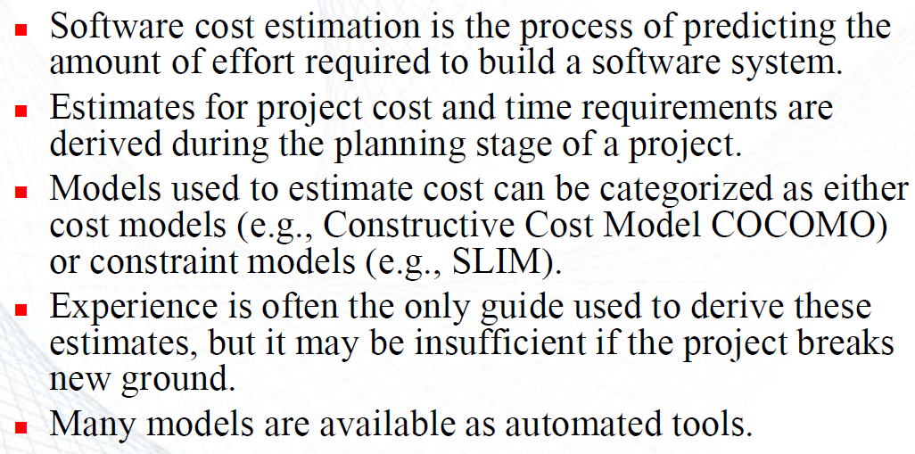
Scope of Software Metrics/1
Cost and effort estimation models and measures

Slide 17
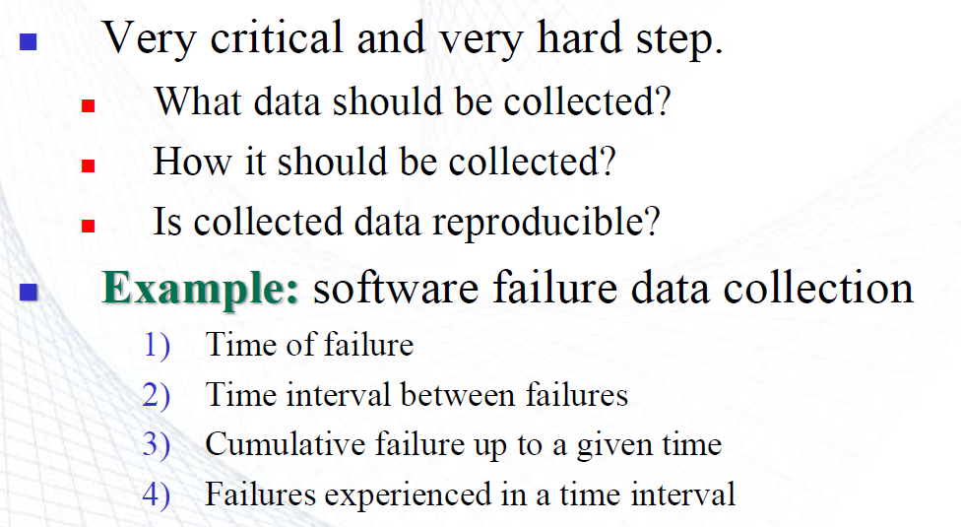
Scope of Software Metrics/2
Data collection

Slide 18
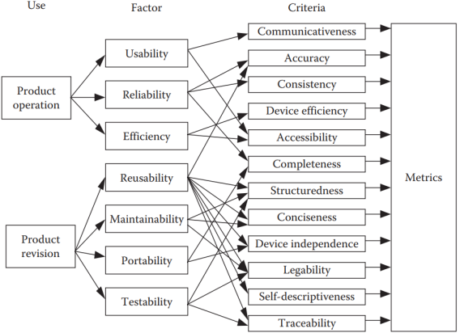
Scope of Software Metrics/3
Quality models and measures

Slide 19
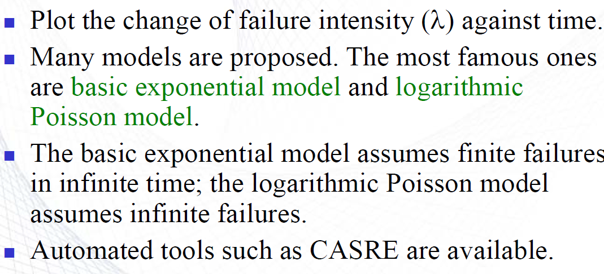
Scope of Software Metrics/4
Reliability models

Slide 20
Scope of Software Metrics/5
Security metrics
Security depends on both the internal design of a system and the nature of the attacks that originate externally.
To assess security risks in terms of impact, likelihood, threats, and vulnerabilities.

Slide 21
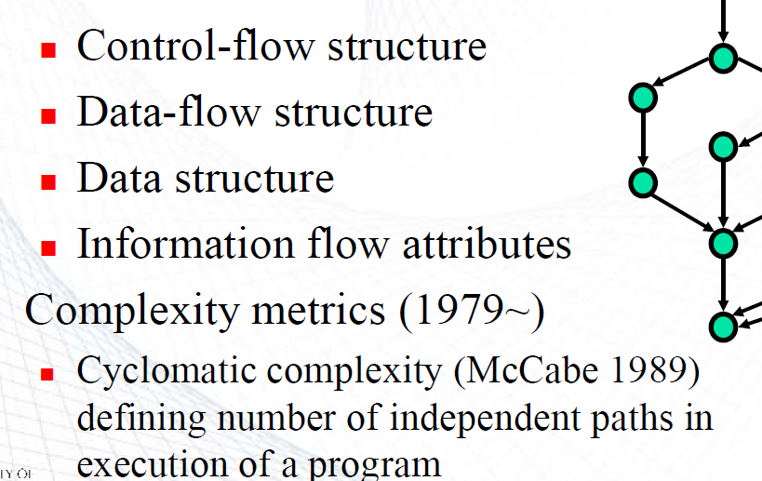
Scope of Software Metrics/6
Structural and complexity metrics

Slide 22
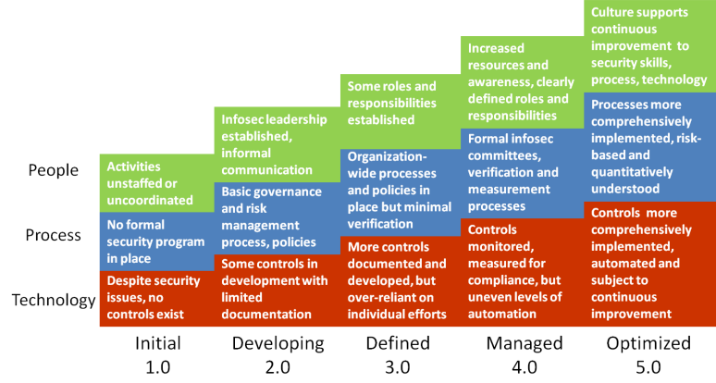
Scope of Software Metrics/7
Capability maturity assessment
Capability Maturity Model Integration (CMMI)

Slide 23
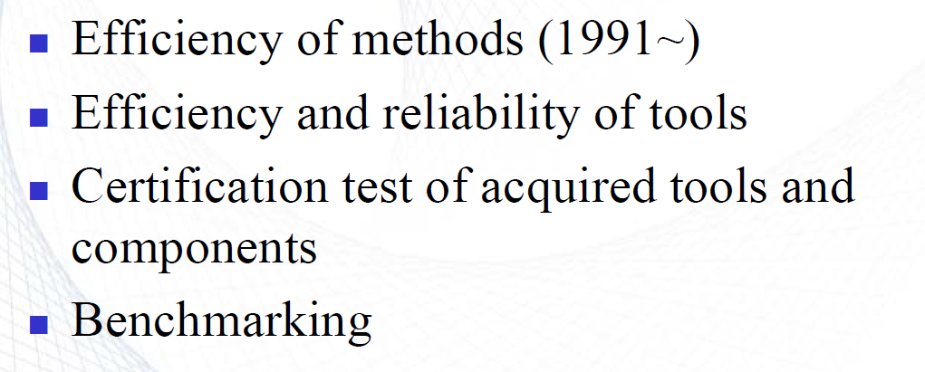
Scope of Software Metrics/8
Evaluation of methods and tools

Slide 24
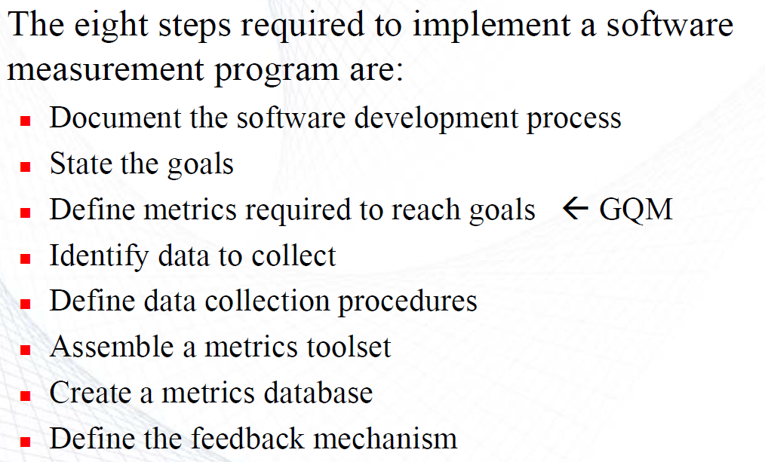
Eight Steps of Measurement Program

Slide 25
End of Chapter 1

